Slide 1


Business Intelligence mit SAP: Strategie, Neuerungen, Nutzen
Andreas Forster / Solution Advisor June 2013

Slide 2
Agenda
SAP Business Intelligence Vision
SAP BusinessObjects Suite
SAP BusinessObjects BI and SAP
Rapid Deployment Services
Questions & Answers

Slide 3

SAP Business Intelligence Vision

Slide 4


Business Intelligence mission
Notes:
The Business Intelligence mission is to connect the data to the people to allow them to make better decisions

Slide 5













New challenges with the data…
:-)
Velocity
Brand Sentiment Higher NPS
Fraud Detection Lower Risk
Risk Mitigation, Real-time
Retain Market Value
Instant Messages
CRM Data
Mobile
Customer
Things
Asset Tracking Increase Productivity
Personalized Care Loyal Customers
Product Recommendation More Sales
Demand
Sales Order
Transactions
Opportunities
Planning
Inventory
Volume
Variety
Propensity to Churn Greater Retention
Real-time Demand/ Supply Forecast More Efficient
360^{O} Customer View Loyal Customers
Notes:
There is no surprise here, one of the key trends is the how much data is growing in volume and variety.
This data needs to be analyzed and harnessed to provide value to the businesses

Slide 6





… cause a growing gap
Mobile
Bigger. Faster. Social.
Simple
Notes:
IT remains resource constrained, and needs to reduce the cost of ownership and to scale the platform to a larger number of users
IT needs the time to manage the data, without being stuck maintaining systems and performance.
So our mission is to deliver the great experiences targeted towards the changing users, while providing IT with the platform to scale and innovate across their business.
That’s a big challenge, but there is good news…

Slide 7






SAP’s vision is to build a network of truth
DATA
PEOPLE
Notes:
IT remains resource constrained, and needs to reduce the cost of ownership and to scale the platform to a larger number of users
IT needs the time to manage the data, without being stuck maintaining systems and performance.
So our mission is to deliver the great experiences targeted towards the changing users, while providing IT with the platform to scale and innovate across their business.
That’s a big challenge, but there is good news…

Slide 8


We Need a “NETWORK OF TRUTH”
From single version of truth
To network of truth

Slide 9


Everyone can consume and contribute
Local View
Enterprise Information Assets
Powered by SAP HANA
Local View
Local View
Local View
Developer
Local View
Local View
Decision Maker
Local View
Local View
Analyst
Notes:
In real Time no aggregates
Our vision at SAP is to close this gap, and enable the intelligent enterprise, where every user will contribute and enrich the network of information.
We build a suit of tools that bring together all the users on a single platform, that scales to address any volume of data and any number of users.
1. we allow Developers and IT, to focus on the "Design" and "Govern“ experiences, where they administer and monitor the platform
2. we allow Analysts to focus on the "Enrich", "Explain", and "Explore" experiences, so that they can produce the right content and analyses
3. Finally, we give the End Users the "Monitor", "Explore" and "Explain" experiences, where they can easily access information and make a case to their colleagues to take better decisions
You can think of Wikipedia as an analogy: at first there were a few specialists that were writing articles for encyclopedia, and it would take years to complete, and print. The updates would traditionally be one volume per year over the course of 20+ years, then came Encarta, then came Wikipedia.
For BI, we have to go through the same revolution, and now start to empower the analysts to create their own content, It still retains the role of moderator, and users contribute too, just by accessing this report rather than this other report, and by the comments they provide back to the authors.
This is the way forward, and SAP provides is innovating by providing an integrated suite of tools that enable IT to cover the needs of all users in the departments.
Our vision is the network of truth
What is unique about us is that we are addressing to make it a tryly contribution system
Introduce Hana
Path to Network of Truth goes through single version of truth that meets the needs of the 3 users
4.1

Slide 10

Analysts Can Consume and Contribute SAP Visual Intelligence - Desktop
Local View
Enterprise Information Assets
Powered by SAP HANA
Local View
Local View
Personal View
Local View
Personal View
Local View
Local View
Analyst
Personal View
Local View
Local View

Slide 11
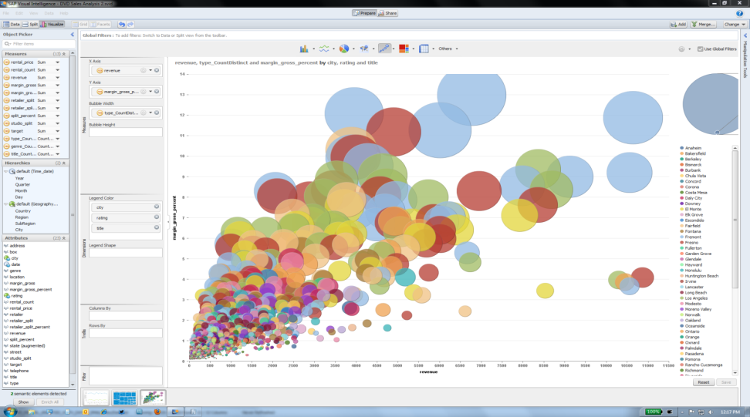
Analysts Can Consume and Contribute SAP Lumira - Desktop

Slide 12





Our Strategic Priorities for SAP BI
Core
Creative
Mobile
Extreme
Social
Scalable Platform
Complete BI suite
Connect IT and departments
Fast time to value
Expand BI to all users
Deliver content at point of impact
Big data
Real time
Predictive
Information in context
Capture the decisions
Innovation without disruption
Notes:
Our strategic areas of investment in BI:
1/ Core BI infrastructure: our first focus is to continue to be the most scalable BI platform in the industry.
The core products include the BI Platform and the Administration Console, WebIntelligence, the Semantic Layer, Crystal Reports...
Our customers don’t have time for downtime.
- For instance at 3M the BI application is one their top IT applications, they have 15000 users, and it has to be up 24 by 7.
- (Check Infosys numbers / went live last year with 100k+ users)
We have invested a lot in the 4.1 release to increase the quality and reliability of our products so that it is aligned with SAP’s brand expectation to be solid and stable.
2/ Creative
A second area of investment is to allow users to be more creative. We want our customers to innovate and to use our solutions in both the IT department and in the lines of business.
We provide a framework where power users can work more in a self service mode, but stay attached to IT infrastructure.
The products in this area include the Analysis products (Analysis for Office and the OLAP edition, as well as Live Office) the new Zen/Design Studio release along with Dashboards, as well as Explorer and Visual Intelligence.
3/ The 3rd area of investment is mobile. We’re focused to deliver all BI content in one single mobile application in the next few quarters. We’ve started a few years ago with WebIntelligence and Crystal reports, we have added Dashboards and Design Studio last year. In the next few months we’re bringing Explorer in the same Mobile BI application (right now it’s a separate application).
4/ The 4th area is Extreme Analytics. With the explosion in data, predictive and data mining is no longer a separate discipline. We want to allow customers want to go beyond simple reporting and look at new ways to understand the data and detect trends and opportunities. By combining a new tool, predictive analysis, with the capabilities of Hana and of the semantic layer, we’re addressing the Big Data challenges
5/ Finally we’re also looking at collaboration, as most decisions are not made in isolation, and require collaboration between people. Here we have an integration with SAP Jam and Streamwork, which are our collaboration solutions.
Overall, our strategy is to continue to innovate without disruption, by allowing our customers to get more from our BI suite, and to leverage their existing investments.

Slide 13
SAP BusinessObjects Business Intelligence Suite

Slide 14










SAP BusinessObjects Business Intelligence Suite
Information Access
through Mobile app, web portals, MS Office and cloud
Self-service
Dashboards and Apps
Reporting
Business Intelligence Platform
Universe Semantic Layer
ERP: SAP Business Suite and other ERPs
BW,TeraData, other DWs
Oracle, DB2, MS SQL and many other DBs
Unstructured data in Social Media and Hadoop
OLAP Cubes
MS Excel
SAP HANA Platform

Slide 15
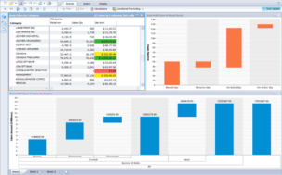
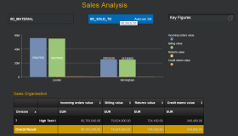

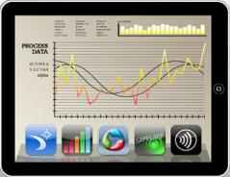
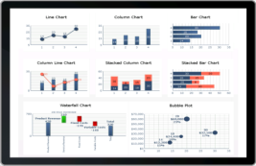

SAP BusinessObjects client tools
Build Custom Experiences
Dashboards and Apps
Self-service
Reporting
Discover. Predict. Create.
Distribute Information
Notes:
For creating BI content, we consistently see three sets of requirements across our customer base
1/ Self-service for the Analyst persona
2/ Dashboards and 3/ Reporting for the Developer persona
For each set of requirements, we have products designed to meet the needs of our diverse customer base.

Slide 16
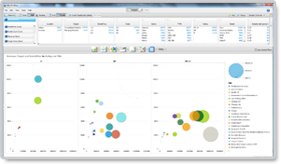
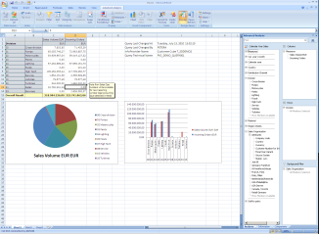
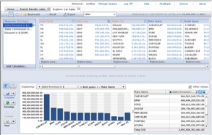
Self-service: Discover. Predict. Create.
Agility for business analysts and business users
Discover trends, outliers and areas of interest in your business
Adapt to business scenarios by combining, manipulating, and enriching data
Tell your story with self-service visualizations and analytics
Forecast and predict future outcomes
Portfolio
Lumira / Predictive Analysis
Explorer
Analysis
Notes:
For Analysts and Power users, we have our Visual Intelligence suite VI desktop and web for being creative with data and applying it to your local context - and then telling great visual stories
Competitive Differentiators:
Ability to quickly massage, transform and personalize data without scripting in Visual Intelligence
Fast answers using search in Explorer
Accessible everywhere – Mobile, Web and Desktop; Online and Offline
Best SAP BW support with Analysis
Customer recommendations:
Net new customers: Lead with Visual Intelligence and Explorer
SAP BW customers: Lead with Analysis
BOBJ customers: Lead with Visual Intelligence and Explorer
* While the Predictive market is separate from the BI market, customers with Discovery and Analysis requirements often have requirements for predictive functionality as well. This presents an opportunity to introduce Predictive Analysis to customers looking at our Discovery and Analysis portfolio.

Slide 17

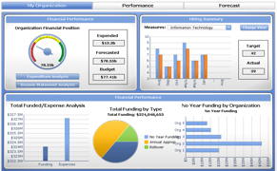
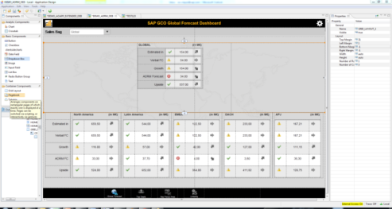
Dashboards and Apps
Build engaging, visual dashboards
Powerful environment to build interactive and visually appealing analytics
Rich set of controls: buttons, list boxes, drop-down, crosstabs, charts…
Use custom code to extend and build workflows
Portfolio
Design Studio
Dashboards (aka Xcelsius)
Notes:
For IT and Developers, we have our Dashboarding solution that allow them to build engaging, flexible content that can be securely shared with end users.
Competitive Differentiators:
Best SAP support with Design Studio
Accessible everywhere – Mobile, Web and Desktop; Online and Offline
Customer recommendations:
Net new customers: Dashboards (Xcelsius)
SAP BW customers: Design Studio
BOBJ customers: Dashboards (Xcelsius)

Slide 18
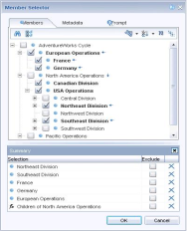
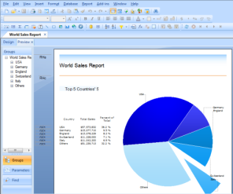
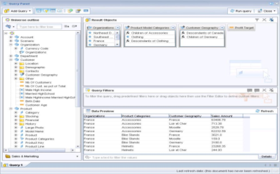
Reporting: share information
High productivity design for report designers
Quickly build formatted reports on any data source
Securely distribute reports both internally and externally
Minimize IT support costs by empowering end users to easily create and modify their own reports
Enhance custom applications with embedded reports
Portfolio
Web Intelligence
Crystal Reports
* SAP BusinessObjects Web Intelligence; SAP Crystal Reports
Notes:
For Reporting, we have the 2 leading reporting tools in the Industry, Web Intelligence and Crystal Reports.
They allow report designers to quickly build highly formatted reports on any data source, and share securely through multiple ways.
- WebI is mostly used to empower users to create or modify their own reports
- Crystal is mostly used by developers for instance as embedded reports with SAP or other application vendors
Competitive Differentiators:
Self-service ad-hoc reporting with Web Intelligence
Depth of SDK and embedability of Crystal Reports
Accessible everywhere – Mobile, Web and Desktop; Online and Offline
Customer recommendations:
Net new customers: Lead with Web Intelligence
SAP BW customers: Depends on use case*
BOBJ customers: Lead with Web Intelligence
OEM and embedded: Crystal Reports

Slide 19

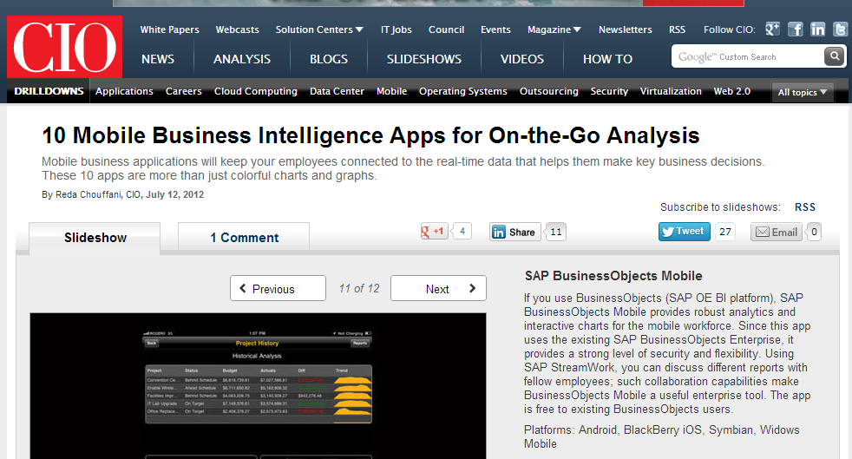
SAP Mobile BI Top Downloaded Mobile Application for Business
SAP BusinessObjects Mobile
Over 500,000 downloads on iTunes!
Notes:
CIO.com ranks Mobile BI in the top apps for business: http://cio.com/slideshow/detail/55953/10-Mobile-Business-Intelligence-Apps-for-On-the-Go-Analysis#slide11

Slide 20

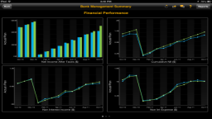
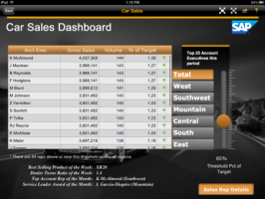
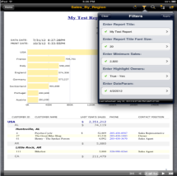
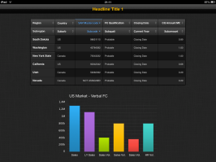
One BI app
SAP BusinessObjects Mobile
Access following new additional content types
SAP BusinessObjects Web Intelligence
SAP BusinessObjects Dashboards
SAP BusinessObjects Design Studio
SAP Crystal Reports
SAP BusinessObjects Mobile
SAP BusinessObjects Mobile
Notes:
CIO.com ranks Mobile BI in the top apps for business: http://cio.com/slideshow/detail/55953/10-Mobile-Business-Intelligence-Apps-for-On-the-Go-Analysis#slide11

Slide 21
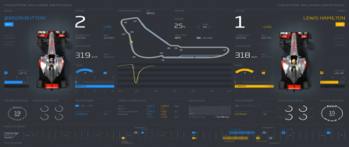
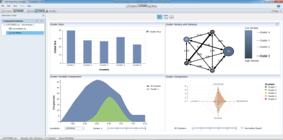
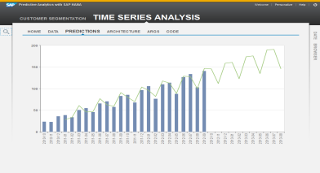
Predictive Analytics with SAP Transforming the Future with Insight Today
Unleash the value of Big Data through the power of SAP HANA
Employ in-database predictive algorithms
Access 3,500+ open-source algorithms via R integration for SAP HANA
Intuitively design and visualize complex predictive models, also without SAP HANA!
SAP Predictive Analysis software
Bring predictive insight to everyone in the business
Embed within business applications
Extend into BI and reports
Insight into events instantly delivered to dashboards, alerts, and mobile devices

Slide 22
SAP BusinessObjects BI and SAP

Slide 23


SAP BusinessObjects Analysis & Design Studio The Premium Alternative to BEx
Analytical Applications
AdHoc OLAP
Web
Design Studio
Premium Alternative to BEx Web App Designer
Design studio for power users to create purpose-built OLAP analysis & planning apps
Mobile support
Customer- and SAP-delivered content
Supporting SAP BW & SAP HANA sources
Analysis, Edition for OLAP
Dedicated Ad-Hoc OLAP client for business users to analyze OLAP data and share it with others
Seamless interoperability between designer and ad-hoc client
Supporting SAP BW & SAP HANA sources + 3rd party OLAP
Microsoft Office
Analysis, Edition for Microsoft Office
IT / Developers, Data Analysts, Business Users
Excel-based OLAP analysis
Excel-based BI applications
Live PowerPoint presentations
Supporting SAP BW & SAP HANA sources

Slide 24


Analysis & Design Studio Designed for BW, BW on HANA & Native HANA Scenarios
Analysis Design Studio
BW Application
MDX
BICS
Universe
SAP HANA
BW-managed schema
Any schema
BICS
MDX
SQL

Slide 25
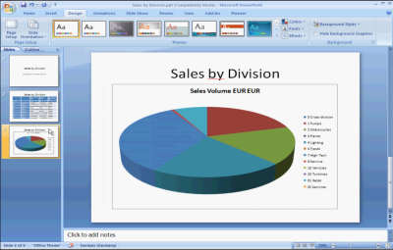
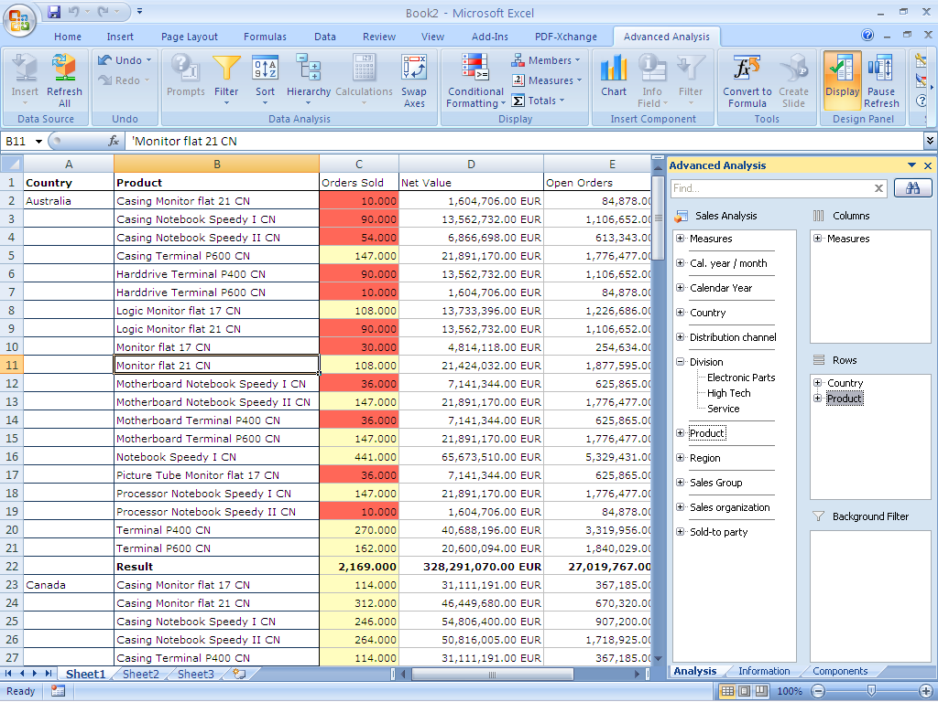
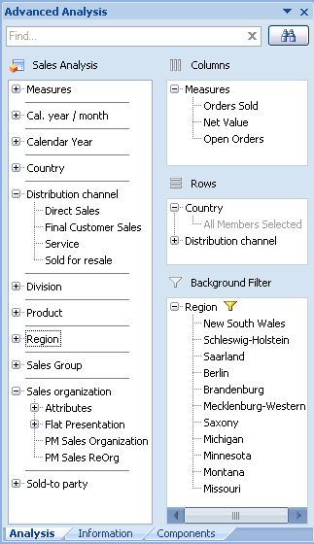
SAP® BusinessObjects™ Analysis, Edition for Microsoft Office Multidimensional Analysis of SAP BW and SAP HANA
Create live PowerPoint presentations
Target User Groups:
BI Professional Business User
Modern and familiar Microsoft Office user experience
Build powerful Excel workbook BI applications
Support BW-Integrated Planning

Slide 26

BusinessObjects Analysis, Edition for Microsoft Office New in Release 1.3
Platform Features
Report-Report Interface (as sender: query, URL)
Variants
Storing workbooks/ppts in BW repository
Launcher (from ABAP transaction)
Innovation
Combine local Excel data with corporate data (using BW Workspaces)
HANA Support
Hierarchies, Prompts, Password Change
Conversion of (simple) BEx workbooks
BW Integration
Activating/deactivating BEx conditions
Corporate Data (SAP BW, SAP HANA)
Local Data
BW Workspaces
Analysis, edition for Microsoft Office
GA since Oct 2012
Notes:
« Variables » (in HANA sense): filter data in analytic view
« Parameters » (in HANA sense): variables that can be used to determine target currency (in currency translation) or processing within analytic view/calc view
→ Both works via prompts
Variables:
A Variable can be specified before executing a query on the view. Usually variable values are entered manually by the user on a UI (variable popup). A variable defines a filter on an attribute of the view. Therefore it always has to be asigned to an attribute. The variable values are passed to the engine via the WHERE clause of the SQL statement. Variables are not known by the engine, but only by the clients like Datapreview, MDX, Advanced Analysis for Office or BO Explorer. It is the task of the client to convert the user input into the WHERE clause when accessing the data.
Parameters or Input Parameters:
A parameter (like a variable) can be specified before executing a query on the view. Usually parameter values are entered manually by the user on a UI (variable popup). A Parameter defines an internal parameterization of the view. This means the engine needs to know it and uses the parameter value during the execution (e.g. to calculate a formula for a calculated measure). The parameter value is passed to the engine via the PLACEHOLDER clause of the SQL statement. A parameter can only have single values. For the end user there is no distinction between variables and parameters. Both appear as input fields on the variable popup.

Slide 27


BusinessObjects Analysis, Edition for Microsoft Office New in Release 1.4
Analysis Suite
Interoperability with Design Studio
Automatic transformation from Analysis Office apps to iPad apps
Enhancemed BI Platform Support
Single Sign-On and LCM (requires BI 4.1)
Innovation
Waterfall Charts
Continuous Improvements
Broadcasting via BI Platform 4.1 (Feature Pack planned for Q3 2013)
Launch Query Designer
Access Mode, Versioned/time-dep hierarchies, de-/activate hierarchies, Data Refresh, Member selector for mass data (note 1824726)
iPad App
Using Design Studio runtime
Analysis, edition for Microsoft Office
GA since June 2013

Slide 28
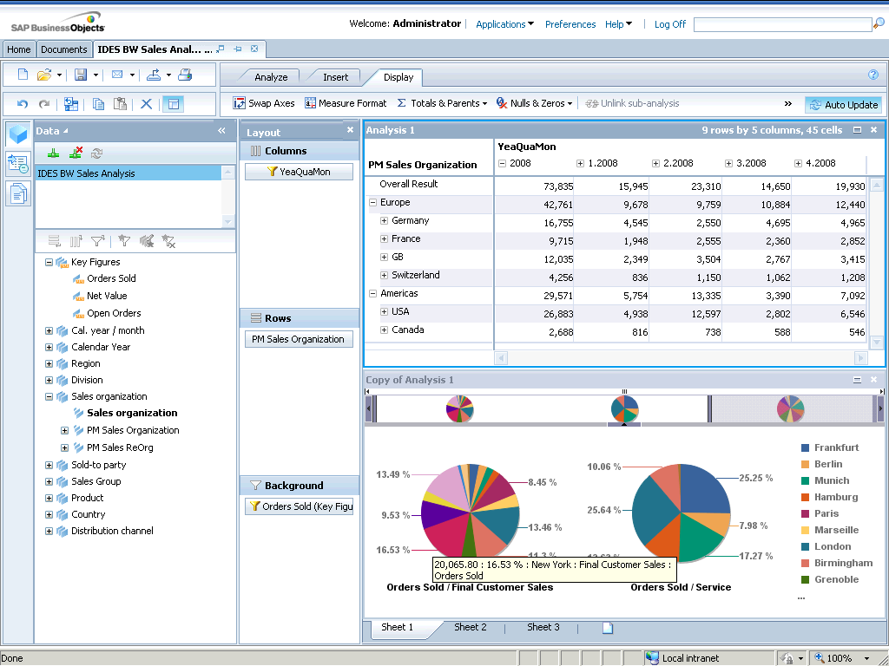
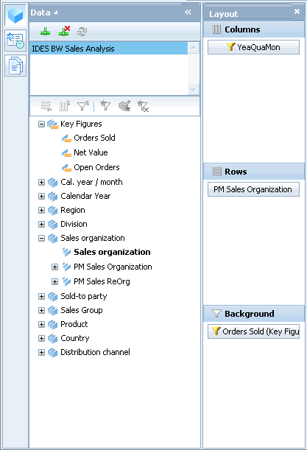
SAP® BusinessObjects™ Analysis, Edition for OLAP The best web client for SAP BW and SAP HANA
Target User Groups:
Data Analysts
Few simple clicks to fast business insights
Pervasive web-based analysis
Interoperate with WebI and Crystal Reports
SAP BW, HANA, EPM, Teradata and Microsoft Analysis Services
Modern look-and-feel with intuitive drag-and-drop
Notes:
Task Panel (hidden)
On the Data tab, you add predefined connections to data sources, and view the dimensions and hierarchies defined in those data sources.
The Pages tab shows the relationships between analyses and visual components (crosstabs and charts) on the on each of the workspace pages.
The Properties tab displays a set of properties for the selected crosstab or chart.
Layout Panel (hidden)
Drop zones are the locations in the "Layout" panel where hierarchies can be dropped to define and manipulate the analysis. Drop zones include the row and column axes and the background filters zone.
Pages
Pages are useful for grouping related analyses together in one workspace.
For example, a workspace might represent the solution to a particular problem, with each page representing a step in the solution.
Tabbed Toolbar
Groups together complementary features
Auto Update
Pause update to perform several navigation steps

Slide 29
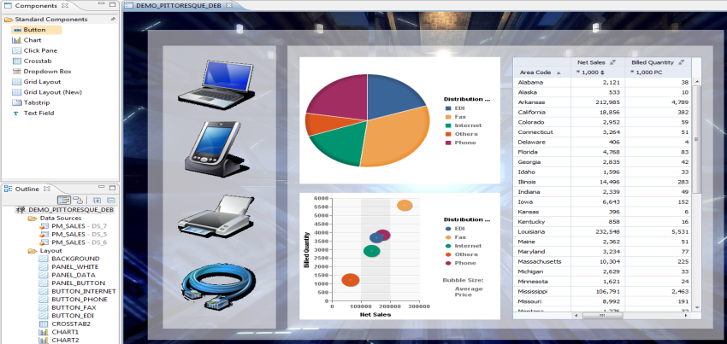
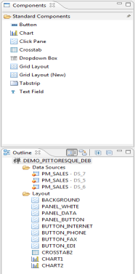
SAP® BusinessObjects™ Design Studio Powerful analytical & planning apps on SAP BW and HANA
Direct Access to BW and HANA via BICS
Target User Groups:
IT Key Users Designers
Eclipse-based application design environment
iPad Apps
Premium alternative to BEx WAD
State of the art rendering: HTML5

Slide 30
SAP Netweaver BW Customers: How to adopt
Step 1: Get Started
Step 2: Replace All BEx Tools
Step 3: Add BW on HANA and other BI Solutions
Self Service
Self Service
Self Service with BW Powered by SAP HANA
SAP BusinessObjects Analysis, edition for Microsoft Office
Reporting and analysis on BW data from within Excel for business users
Excel addin
Next generation of BEx Analyzer
SAP BusinessObjects Analysis, edition for OLAP
Reporting and analysis on BW data from the web for business users
Web based
Next generation of BEx Web Analyzer
SAP Visual Intelligence
SAP BusinessObjects Explorer
Desktop and Web
Accelerate data discovery workflows with in memory aggregation
Dashboards and apps
Reporting
SAP BusinessObjects Design Studio
For graphical dashboards and analytic applications
Next generation of BEx Web Application Designer
SAP Crystal Reports
SAP BusinessObjects Web Intelligence
SAP Crystal Reports for highly formatted production reporting
SAP BusinessObjects Web Intelligence for interactive reporting by business users

Slide 31
BEx to SAP BusinessObjects Cheat Sheet
BI Needs | SAP BEx | SAP BusinessObjects BI
Excel-based analysis (OLAP) | BEx Analyzer | Analysis, edition for MS Office
Web-based analysis (OLAP) | BEx Web Analyzer/Templates | Analysis, edition for OLAP
Application Design / Dashboards | BEx Web Application Designer | Design Studio
Reporting – Enterprise | BEx Report Designer | Crystal Reports
Reporting – Ad-hoc | No equivalent in the BEx suite Best for reporting use cases. Analytical workflows should use the Analysis products | Web Intelligence
Self-Service | No equivalent in the BEx suite Best with BW on HANA and HANA managed schemas | Explorer / Visual Intelligence
Predictive | No equivalent in the BEx suite Rrequires SAP HANA Enterprise edition, Universes, Excel, SQL sources. | Predictive Analysis

Slide 32
SAP HANA Live deployment options
Existing Stack
Sidecar Approach
Integrated Stack
SAP Frontend
SAP Frontend
BOBJ
BOBJ
HTML 5
HTML 5
SAP Business Suite (ERP, CRM, SCM,…)
SAP Business Suite (ERP, CRM, SCM,…)
Any frontend
Any frontend
SAP HANA
SAP HANA
SAP HANA Live
SAP HANA Live
AnyDB
Replication
Customers can add new analytics capabilities immediately without disruption to their existing landscape. Any investment today will be valid for SAP Business Suite powered by SAP HANA.
Notes:
This is important to show the “innovation without disruption” message.

Slide 33
Rapid Deployment Solutions

Slide 34
SAP BusinessObjects BI Rapid Deployment Solutions (RDS) and Services
Service Name | Content | Category | Availability
Roadmap assessment for Business Intelligence | The SAP BI Roadmap Assessment provides customers with a recommended business intelligence roadmap, based on their specific requirements and business challenges, suggesting new areas of the business where business intelligence could offer strategic benefits | Standardized Service | Yes
Predefined business intelligence assessment for SAP BusinessObjects BI | This service is designed to assist customers to have Better understanding of the Enterprise platform and reporting methodology/choices , Better understanding of SAP XI and BI capabilities , identifying potential areas of risk, Improved performance results, Tool assessment, road mapping and opportunities to leverage new functionality in the new release. | Engineered Service | Yes
Predefined Upgrade Assessment for BI Platform | Customers who desire to upgrade their SAP BusinessObjects BI deployments to the latest version of the SAP BusinessObjects BI Platform and tools often lack the knoweldge and experience to plan and execute a major software upgrade or may be unsure of what kinds of issues they may encounter, what it will really cost, or how long it will take to complete such an upgrade | Engineered Service | Yes
Installation of SAP BusinessObjects BI | Two basic components included in the installation of SAP BusinessObjects BI service: SAP BusinessObjects BI installation and configuration Install and configure SAP BusinessObjects BI in a development (or pilot) environment Create installation documentation Forward-looking advisory services Best practices on the implementation of the Security Model Best practices on the SAP BusinessObjects purchased tools Advice on which tools to use when Next steps for moving forward | Engineered Service | Yes

Slide 35
SAP BusinessObjects BI Rapid Deployment Solutions (RDS) and Services
Service Name | Content | Category | Availability
Architecture design for BI reporting | The scope of the Project aims to build an Architecture Framework as a blueprint towards implementation of Business Objects for their enterprise. The Architecture Design for BI Reporting includes planning a scalable Business Objects solution for variety of operating systems, application servers, authentication strategies and various database connectivities. SAP will engage with the customer to perform an evaluation of the reporting landscape, including reporting requirements, existing reporting databases, and company standards | Engineered Service | Yes
Implementation service for SAP Business Objects Explorer | This service provides for the configuration of Accelerated Explorer in a customer's development or POC environment. This service allows a customer to rapidly install and develop SBO Explorer as either the first step of a production deployment or as a POC. The service includes installation of the Explorer software, configuration of the InfoSpace, and loading of a single Infospace in Explorer for reporting | Engineered Service | Yes
Upgrade to SAP BusinessObjects Business Intelligence Platform | The Upgrade for BI Platform is a standardized service to help customers upgrade their existing SAP BusinessObjects BI platform and reports, analytics, dashboards, etc. to the latest SAP BusinessObjects BI platform and technology. This service is offered in phased increments to help the customer understand and pilot the process while keeping costs to a minimum. | Standardized Service | Yes
Solution Migration to BI Platform from 3rd Party Products | Is a standardized service to help customers migrate their existing reports, analytics, dashboards, and other Business Intelligence (BI) solutions to a new solution using the latest SAP BusinessObjects BI platform and technology. It is a comprehensive "end-to-end" service offering where SAP will manage and execute the migration project from requirements through deployment to ensure customer success. In this service, SAP Consulting will design, install, and configure a new BI technical landscape (system and software) using the SAP BusinessObjects BI platform and then design, develop, and deploy new BI content (reports, dashboards, etc.) using SAP BusinessObjects BI technology to replace the existing BI solution and content. | Standardized Service | Yes

Slide 36
SAP BusinessObjects BI Rapid Deployment Solutions (RDS) and Services
Service Name | Content | Category | Availability
Rapid Deployment of SAP HANA Data Services, Rapid Marts, and BI Platform | Accelerated BI and DS RDS for HANA delivers the SAP BusinessObjects BI Platform, BusinessObjects Explorer and Data Services applications pre configured for reporting, analyzing and loading HANA. This package also includes one Rapid Mart, which provides prebuilt analytical reporting and analysis, along with extraction routines, transformations, loading, universes and initial reports. | RDS | Yes
Planning Assessment for Predictive Analysis | The Planning assessment for predictive analysis Includes: Identified use cases with highest possible ROI. Roadmap to predictive analysis maturity Enablement plans for different user groups | Standardized Service | June 2013
Implementation of Predictive Analysis using HANA | The Implementation of predictive analysis Includes: Identified use cases with highest possible ROI. Roadmap to predictive analytics maturity Build predictive model to address use case using SAP PA. Visualization using built in VI Enablement plans for different user groups Data model in HANA to support predictive model Performance maximization on HANA | Standardized Service | June 2013

Slide 37
SAP BusinessObjects BI Rapid Deployment Solutions (RDS) and Services
Service Name | Content | Category | Availability
SAP Business Objects Mobile BI - Initialization Service | Service to initialize SAP BusinessObjects Mobile BI capability's on Top of existing SAP BusinessObjects BI Platforms. The service includes: Installation & Configuration of Mobile Services on top of Business Objects Platform Development of Dataset & 3 Sample Report for SAP Business Objects Mobile Analytics App Configuration of SAP Business Objects Mobile Analytics App to display content Optional deployment package for Afaria MDM available | Localized CH Service | Yes
SAP BI Strategy – Social BI Strategy Service | The Social BI Strategy Service is designed to provide an assessment of your BI Framework and to learn how to integrate data and information from social media networks such as Facebook, Twitter, Delicious and more in your Business Intelligence strategy. The service includes: Social BI Introduction: Understand the core pillars of Social BI and how your organization can benefit from it Social BI Roadmap: Detailed customized Roadmap that highlights the important areas that are relevant for your business and IT Recommendations: Final presentation with detailed recommendations and next steps | Localized CH Service | Yes

Slide 38

Zusammenfassung – 5 6 Punkte zum Mitnehmen
Benefit from the latest innovation of SAP BusinessObjects BI 4.x
BW Customers: Move to the strategic Front-Ends
Consider SAP HANA Live for Operational Reporting
Go Mobile
Talk with SAP about your Data Mining requirements
Play with SAP Lumira and provide Self Service BI to your users

Slide 39
Thank you
Contact information:
Andreas Forster
Solution Advisor
SAP Schweiz
+41 797 01 8944, andreas.forster@sap.com

Slide 40
声明：
所有的版权属于原有公司，文件均来自公开渠道
此文件仅供学习使用，任何人不得进行以此为商业目的的行为
如有疑问，请立即删除
学习世界五百强和咨询公司PPT课程请访问如下网站搜索：“司马懿”
百度传课：司马懿PPT学校
网易学堂：司马懿PPT学校
知乎： 司马懿PPT学校
访问地址
https://www.chuanke.com
访问地址
https://study.163.com
访问地址
https://www.zhiu.com

